Slide 1
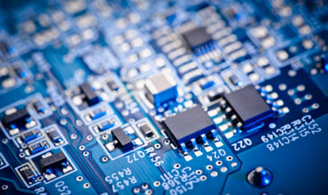
Basic concepts
Instructor: Jonathan Vargas
Web: www.jonathanvargas.ml

Slide 2
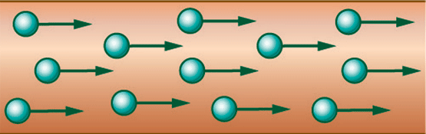
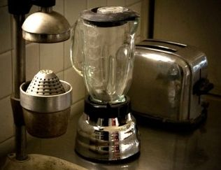
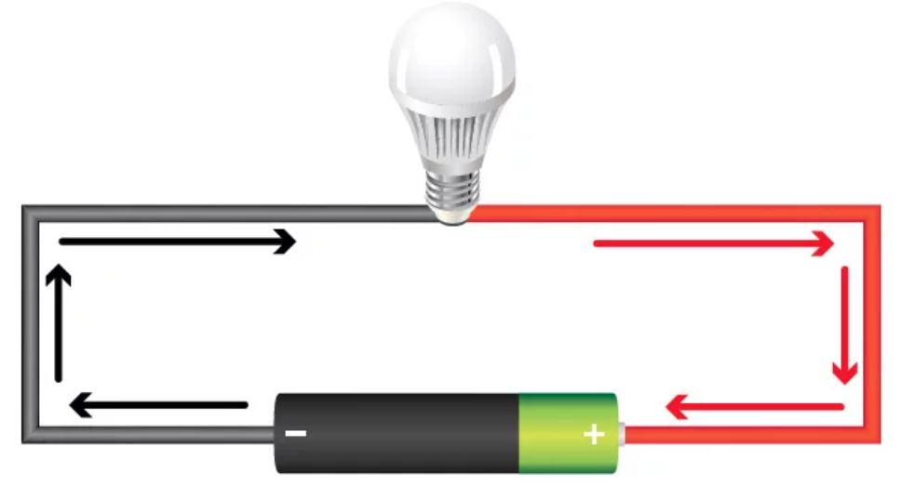
Current
Voltage
Power
Flow of electrons through a conductor or semiconductor.
I
[A] amperes
It is the force that move electrons through a conductor or semiconductor.
V
[V] volts
It is the speed at which electrical energy is consumed.
P
[w] watts
P=I*V

Slide 3
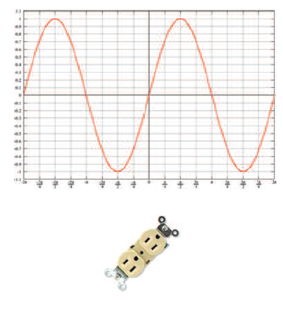
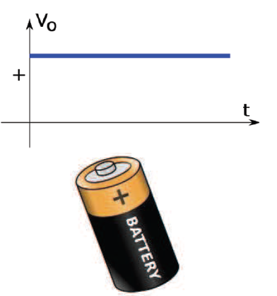
DC Voltage
AC voltage

Slide 4
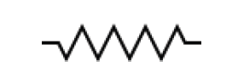
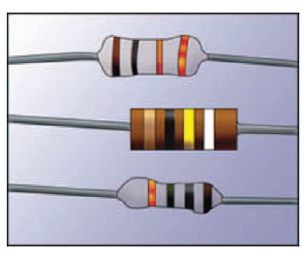
Resistor
Resistance is the physical property of elements to oppose to current flux.
A resistor is an electrical component which uses resistance as its main feature in electrical circuits.
[Ω] Ohms.

Slide 5
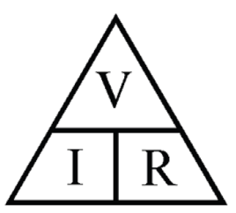
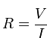
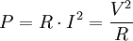
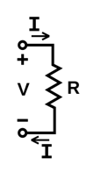
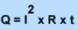
Resistor effects
Ohm Law
The relationship between current and voltage in a close circuit is a constant, the material resistance.
Joule effect
Through a conduct in which current flow, part of energy is dissipated as heat due to electrons collision.

Slide 6
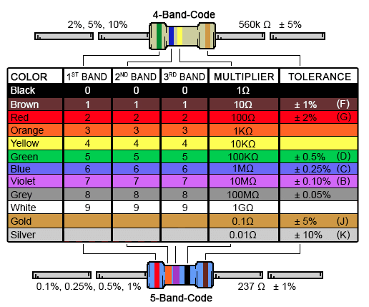
Resistor color code

Slide 7
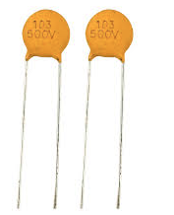
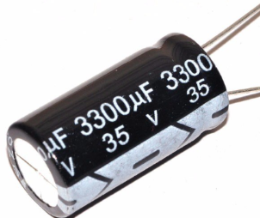
Capacitor
Capacitance is the ratio of the change in a electrical charge. They are able to accumulate electrons.
A capacitor is an electrical component which uses capacitance as its main feature in electrical circuits.
[F] Farad
[nF] and [uF]

Slide 8
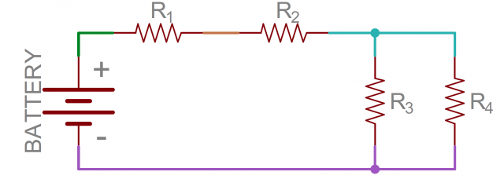
Serie and parallel circuits

Slide 9
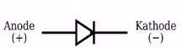
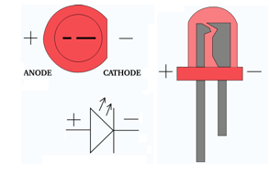
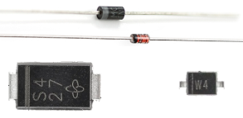
Diodes
They are electronic components which allow current flow in just a sense.

Slide 10
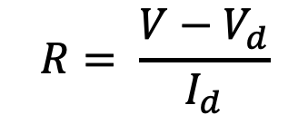
LED circuits
$$R= \frac{V−V_{d}}{I_{d}}$$

Slide 11
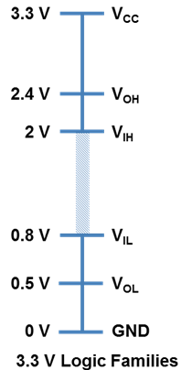
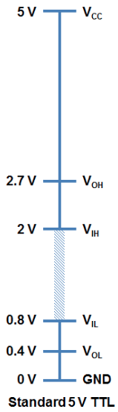
Logic voltages

